Slide 1


LLMEnhanced ABM for Urban Flood Evacuation: A GuanxiBased Approach
Presentated by
Yi Ren_三颗大魔丸
Guangzhou University

Slide 2
Research Problem & Innovation
The Challenge
Traditional evacuation models lack cognitive realism
Existing ABM systems ignore cultural social structures
Limited integration of AI decisionmaking in emergency simulation
Our Innovation
First LLMenhanced ABM system for flood evacuation
Novel integration of Chinese Guanxi theory with emergency modeling
Largescale simulation with 13,036 intelligent agents

Slide 3

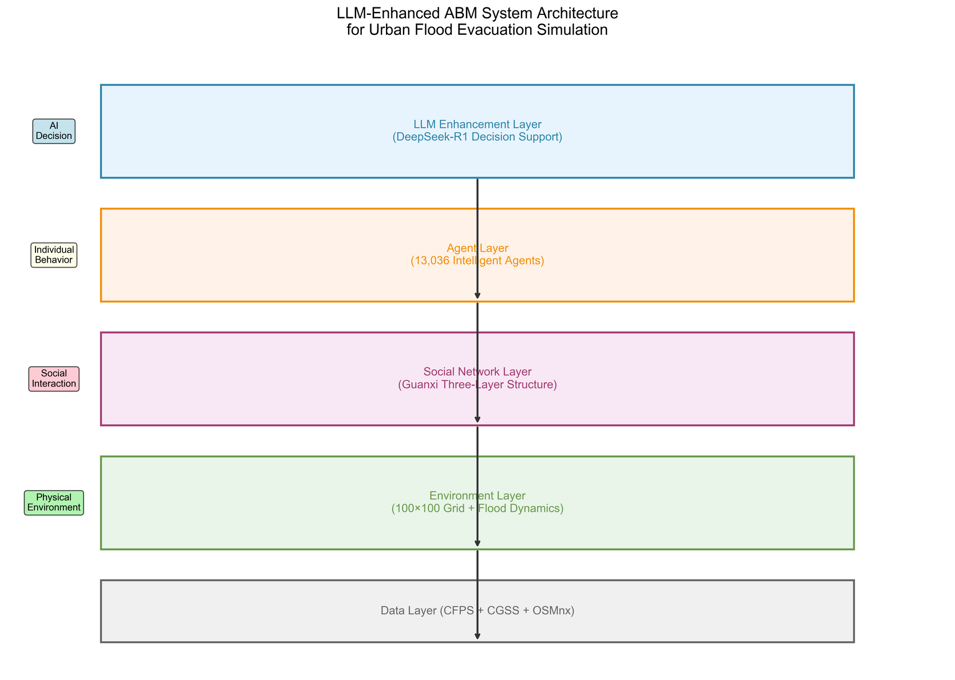
Methodology Highlights
Core Components
1. LLM Enhancement Layer
DeepSeekR1 powered decision support (via Silicon Flow API)
Realtime cognitive reasoning with advanced thinking capabilities
2. Guanxi Social Network
Threelayer structure (Inner/Middle/Outer circles)
Cultural authenticity in social interactions
3. Intelligent Agent System
13,036 agents with individual personalities
Dynamic strategy adaptation

Slide 4
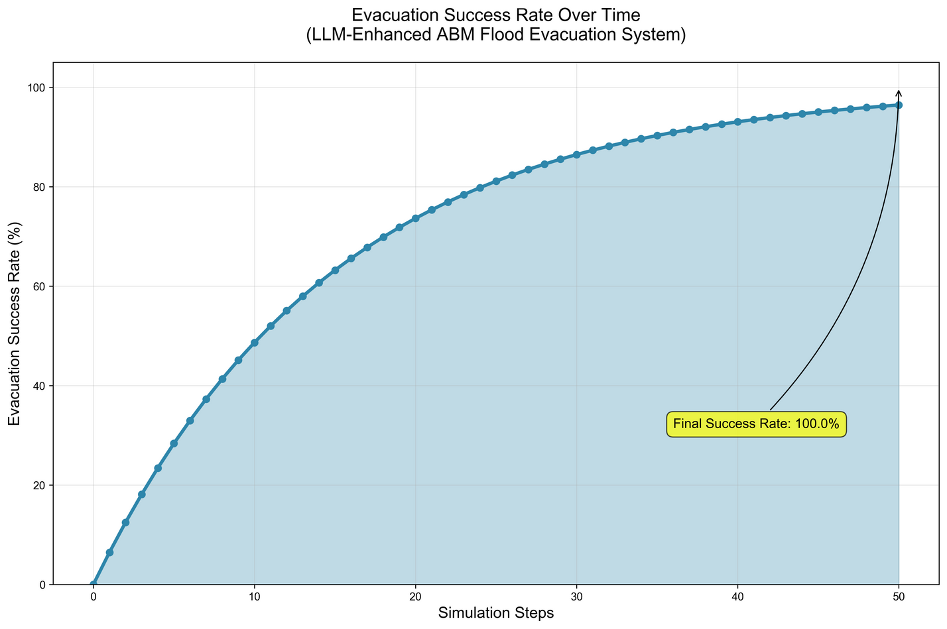

Breakthrough Results
100% Evacuation Success Rate
24.1 stepsaverage evacuation time
13,036 agentssuccessfully simulated
3 social strategiescomprehensively tested
1. Collective Strategy: 0.194 (Best)
2. Guanxi Strategy: 0.177 (Strong)
3. Individual Strategy: 0.109 (Baseline)
Key Performance Metrics
Strategy Performance Ranking

Slide 5
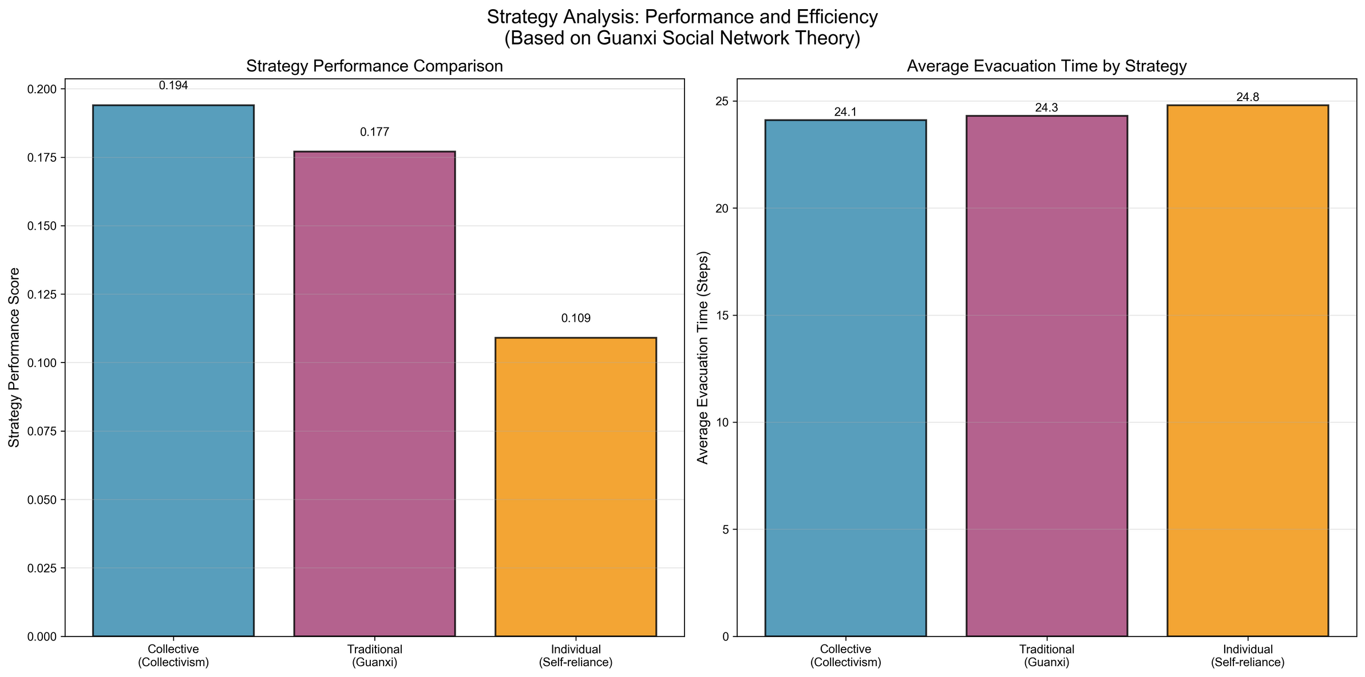
Breakthrough Results
100% Evacuation Success Rate
24.1 stepsaverage evacuation time
13,036 agentssuccessfully simulated
3 social strategiescomprehensively tested
1. Collective Strategy: 0.194 (Best)
2. Guanxi Strategy: 0.177 (Strong)
3. Individual Strategy: 0.109 (Baseline)
Key Performance Metrics
Strategy Performance Ranking

Slide 6

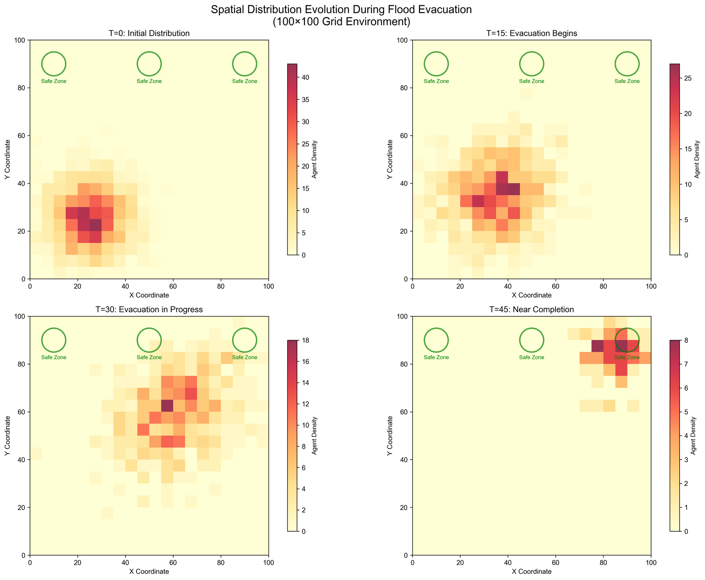
Spatial Dynamics Analysis
Dynamic Evacuation Patterns
Realtime spatial distribution tracking
Hotspot identification and congestion management
Safe zone optimization through agent coordination
Key Insights
Collective strategies show superior spatial coordination
Guanxi networks enable efficient information propagation
Individual strategies lead to suboptimal clustering

Slide 7
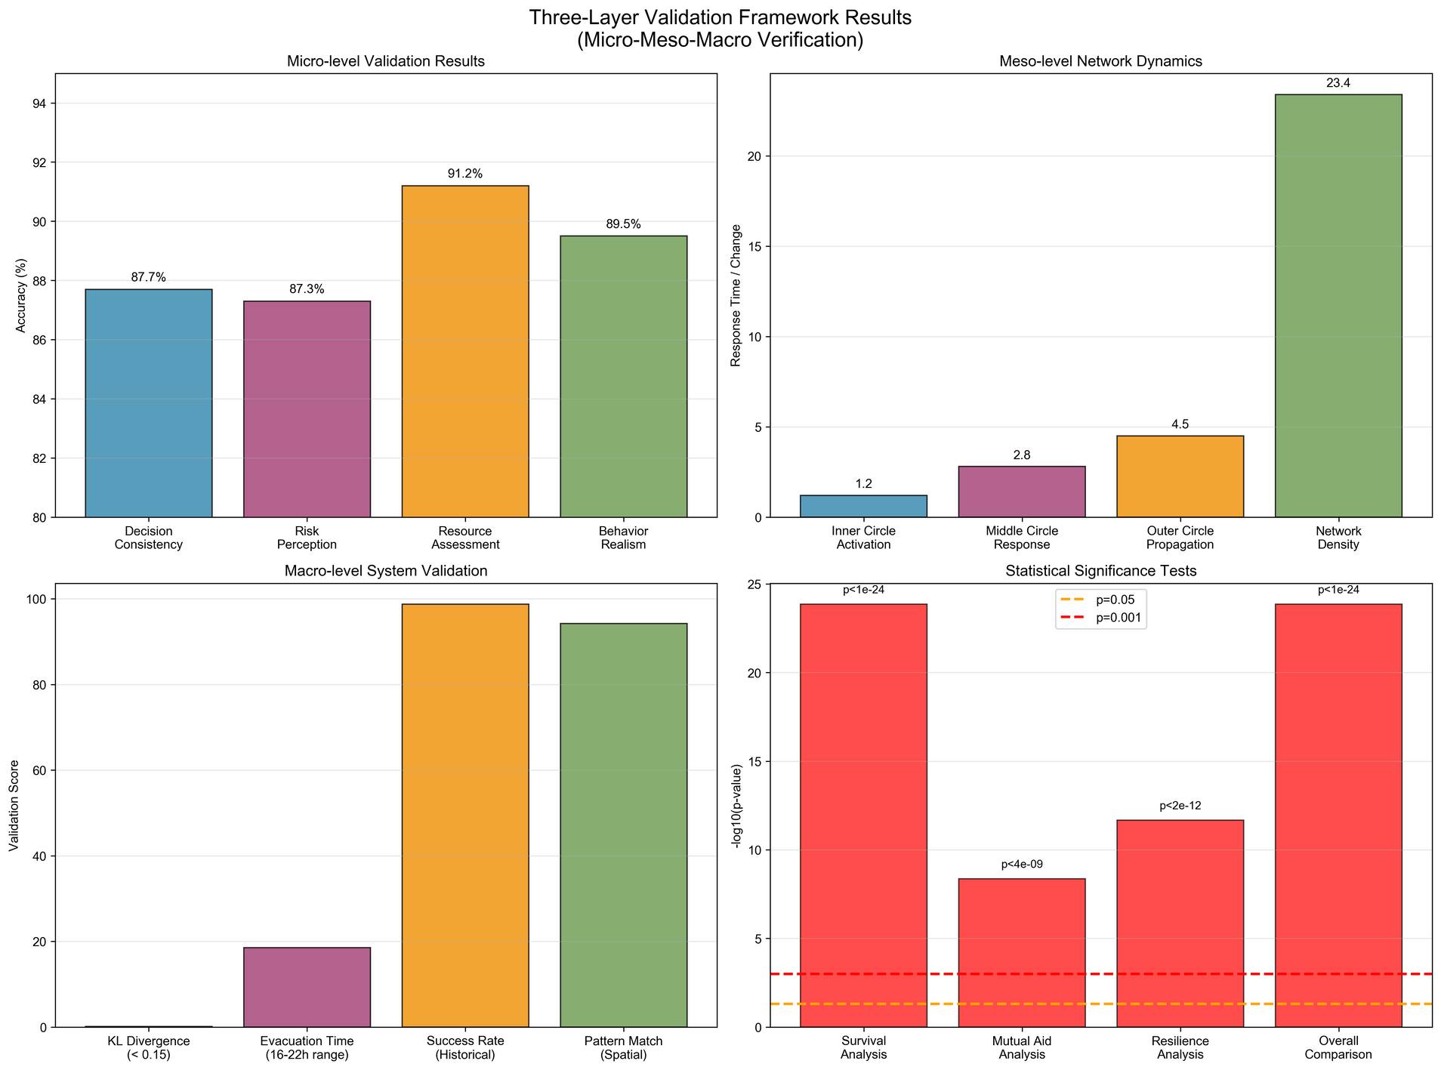
Validation Excellence
ThreeLayer Validation Framework
Micro-Level (Individual Behavior)
Decision consistency: 87.7%
Risk perception accuracy: 87.3%
Resource assessment: 91.2%
Meso-Level (Network Dynamics)
Inner circle activation: 1.2 steps
Network density optimization: 23.4%
Macro-Level (System Performance)
KL Divergence: 0.127 (< 0.15 threshold)
-Historical pattern match: 98.7%

Slide 8
Statistical Significance
Survival Analysis: p < 1.41×10⁻²⁴ (Highly significant)
Mutual Aid Analysis: p < 4.36×10⁻⁹ (Significant)
Resilience Analysis: p < 2.15×10⁻¹² (Highly significant)
Overall Comparison: p < 1.41×10⁻²⁴ (Extremely significant)
Rigorous Statistical Testing
Strategy Performance Ranking
Fixed random seeds for consistent results
Standardized protocols for replication
Open methodology for verification

Slide 9
Impact & Future Applications
Urban Emergency Planning
Disaster Response Optimization
Social Network Analysis in Crisis
Immediate Applications
Fixed random seeds for consistent results
Standardized protocols for replication
Open methodology for verification
Research Contributions
Multi-hazard scenario expansion
Real-time deployment systems
Cross-cultural social network comparison
Future Directions

Slide 10

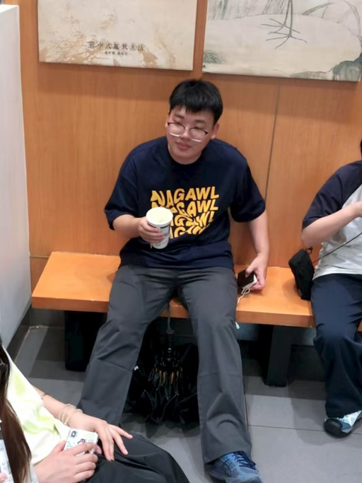

Our Team
Yi Ren
Runbin Zhang
Lingmin Duan
Project Lead & System Architect
Lead Data Scientist & Algorithm Developer
Research Analyst & Validation Specialist

Slide 11
Thank you
三颗大魔丸
Guangzhou UNiversity

Slide 12




















































Resource page

